Slide 1


Slide 2
Physics For Engineers
NS (110)
Lecture # 14&15
Date: 30th Sept & 1st Oct, 2019

Slide 3
Oscillations

Slide 4
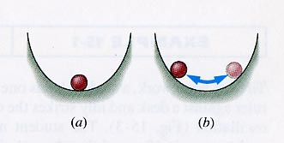
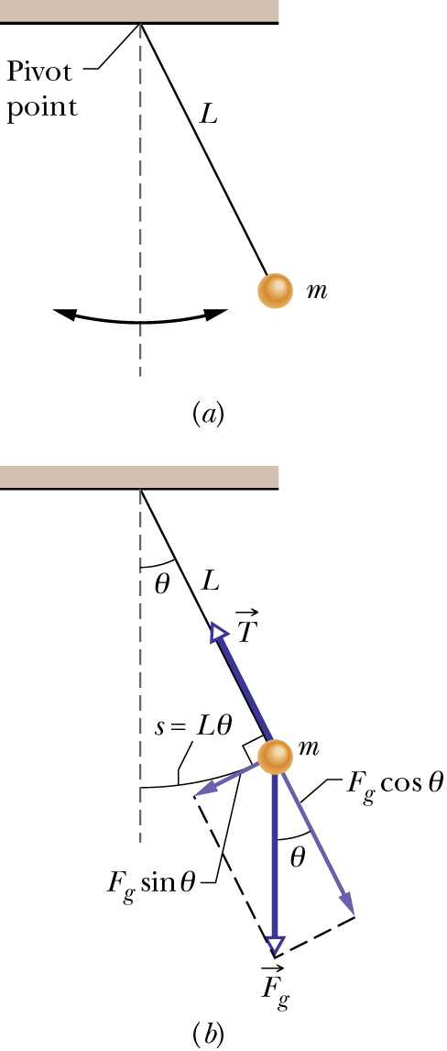
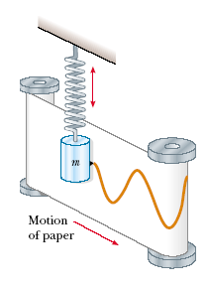
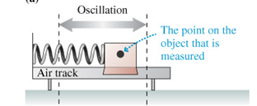
Oscillatory motion
A
Motion which is periodic in time, that is, motion that repeats itself in time.
Examples:
Power line oscillates when the wind blows past it
Earthquake oscillations move buildings
  Sometimes the oscillations are so severe, that the system exhibiting oscillations break apart.

Slide 5
Simple Harmonic Motion
Simple harmonic motion (SHM) refers to a certain kind of oscillatory, or wave-like motion that describes the behavior of many physical phenomena:
  a pendulum
  a bob attached to a spring
  low amplitude waves in air (sound), water, the ground
  the electromagnetic field of laser light
  vibration of a plucked guitar string
  the electric current of most AC power supplies

Slide 6
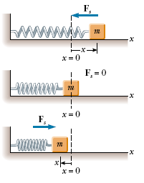

Simple Harmonic Motion
When the block is displaced a small distance x from equilibrium, the spring exerts on the block a force that is proportional to the displacement and given by Hoo ke’s law
An object moves with simple harmonic motion whenever its acceleration is proportional to its displacement from some equilibrium position and is oppositely directed.

Slide 7
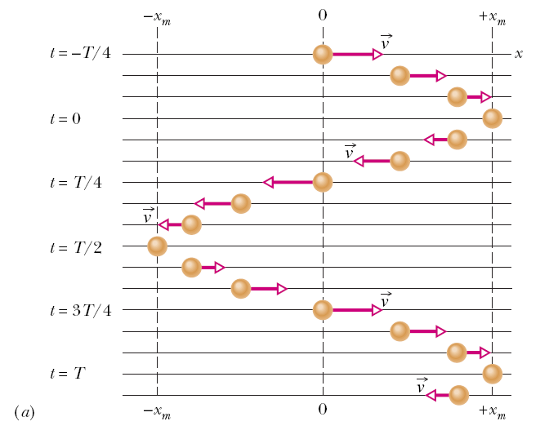
Simple Harmonic Motion
In the figure snapshots of a simple oscillatory system is shown. A particle repeatedly moves back and forth about the point x=0.
The time taken for one complete oscillation is the period, T. In the time of one T, the system travels from x=+x_{m}, to –x_{m}, and then back to its original position x_{m}.
The velocity vector arrows are scaled to indicate the magnitude of the speed of the system at different times. At x=±x_{m}, the velocity is zero.

Slide 8
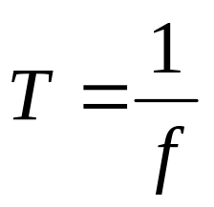
Simple Harmonic Motion
Frequency of oscillation is the number of oscillations that are completed in each second.
The symbol for frequency is f, and the SI unit is the hertz (abbreviated as Hz).
It follows that

Slide 9
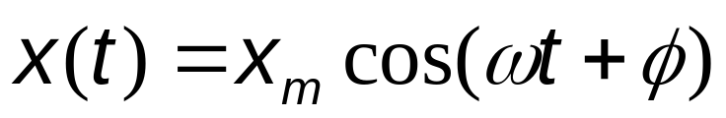
Simple Harmonic Motion
Any motion that repeats itself is periodic or harmonic.
If the motion is a sinusoidal function of time, it is called simple harmonic motion (SHM).
Mathematically SHM can be expressed as:
Here,
x_{m} is the amplitude (maximum displacement of the system)
t is the time
ω is the angular frequency, and
φ is the phase constant or phase angle

Slide 10
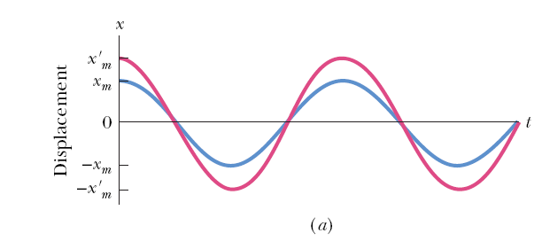
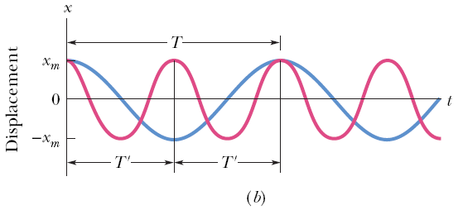
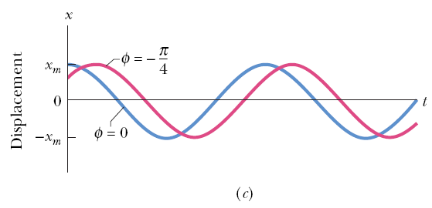
Simple Harmonic Motion
Figure a plots the displacement of two SHM systems that are different in amplitudes, but have the same period.
Figure b plots the displacement of two SHM systems which are different in periods but have the same amplitude.
The value of the phase constant term, φ, depends on the value of the displacement and the velocity of the system at time t = 0.
Figure c plots the displacement of two SHM systems having the same period and amplitude, but different phase constants.

Slide 11

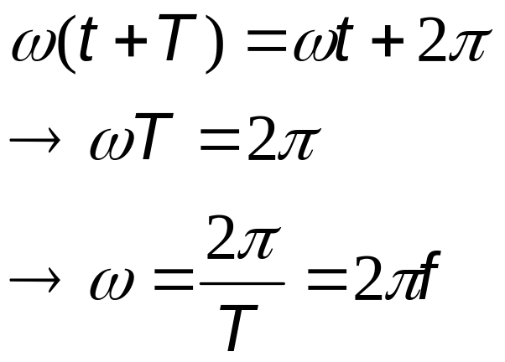
Simple Harmonic Motion
For an oscillatory motion with period T,
The cosine function also repeats itself when the argument increases by 2π. Therefore,
Here, ω is the angular frequency, and measures the angle per unit time. Its SI unit is radians/second. To be consistent, φ then must be in radians.

Slide 12
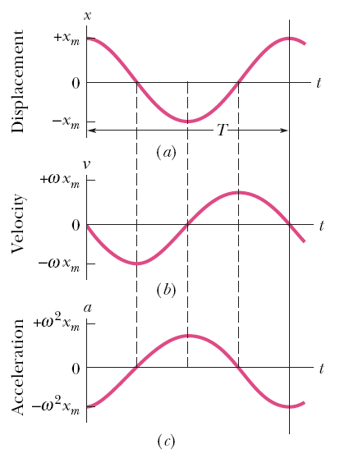
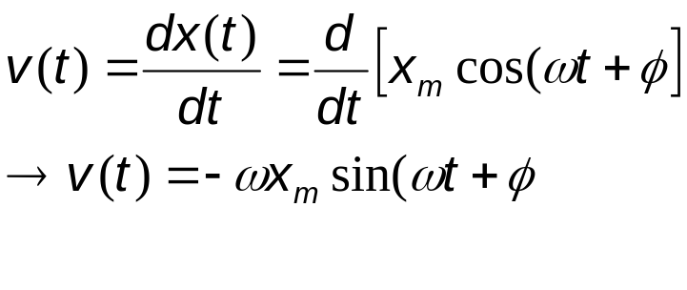
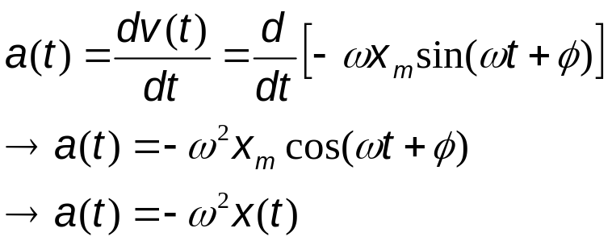
Simple Harmonic Motion
The velocity of SHM:
The maximum value (amplitude) of velocity is ωx_{m}. The phase shift of the velocity is π/2, making the cosine to a sine function.
The acceleration of SHM is:
The acceleration amplitude is ω²x_{m}.
In SHM a(t) is proportional to the displacement but opposite in sign.

Slide 13

Force Law for SHM
From Newton’s 2nd law:
SHM is the motion executed by a system subject to a force that is proportional to the displacement of the system but opposite in sign.

Slide 14
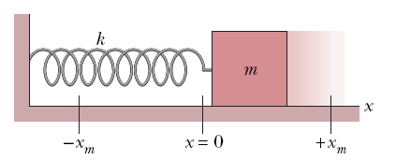
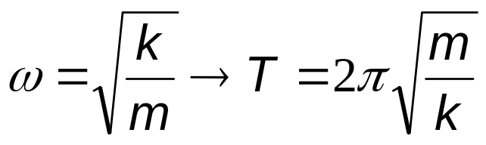
Force Law for SHM
The block-spring system shown on the right forms a linear SHM oscillator.
The spring constant of the spring, k, is related to the angular frequency, ω, of the oscillator:

Slide 15
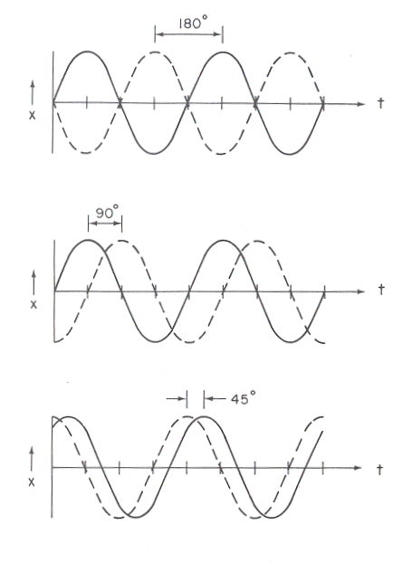
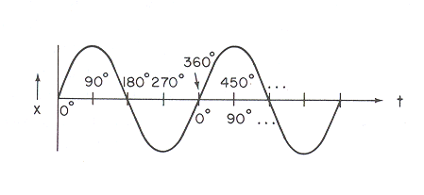
Phase (Time) Phase Diffference

Slide 16

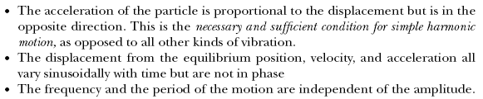

Slide 17
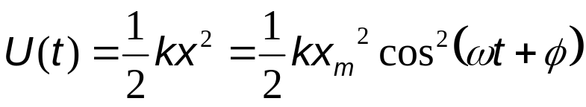
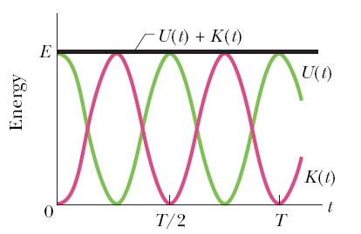
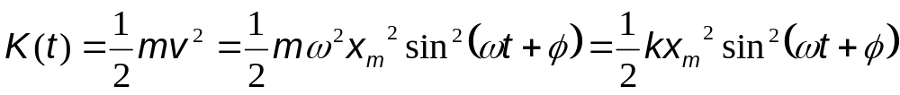
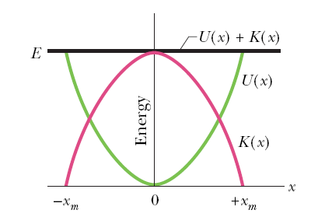
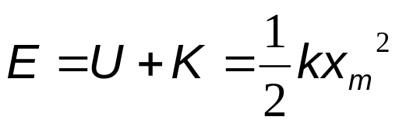
Energy in SHM
The potential energy of a linear oscillator is associated entirely with the spring.
The kinetic energy of the system is associated entirely with the speed of the block.
The total mechanical energy of the system:

Slide 18
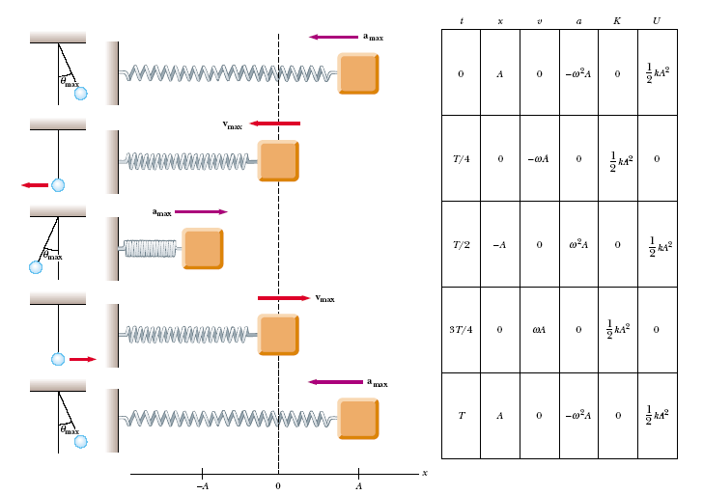


Slide 19
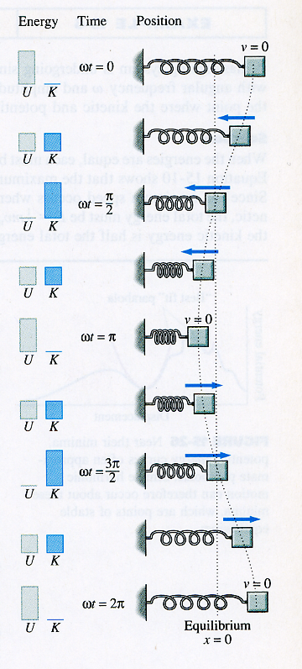

Slide 20
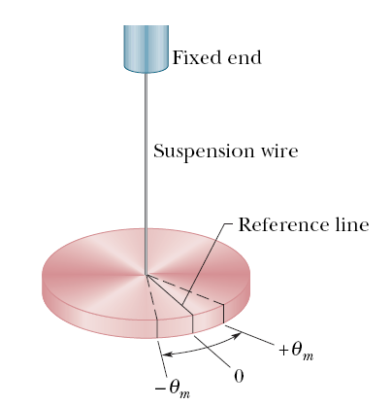
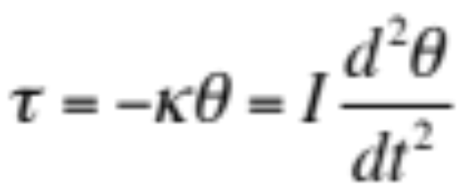
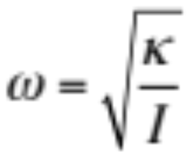
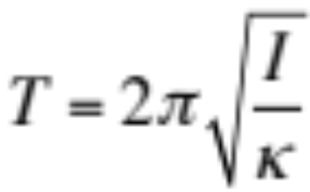
Simple Harmonic Motion
An angular SHM:
The figure shows a torsion pendulum, which involves the twisting of a suspension wire as the disk oscillates in a horizontal plane.
The torque associated with an angular displacement of θ is given by:
κ is the torsion constant, which depends on the length, diameter, and material of the suspension wire, and I is the moment of inertia (rotational inertia) of the disk.
The period, T, is then

Slide 21
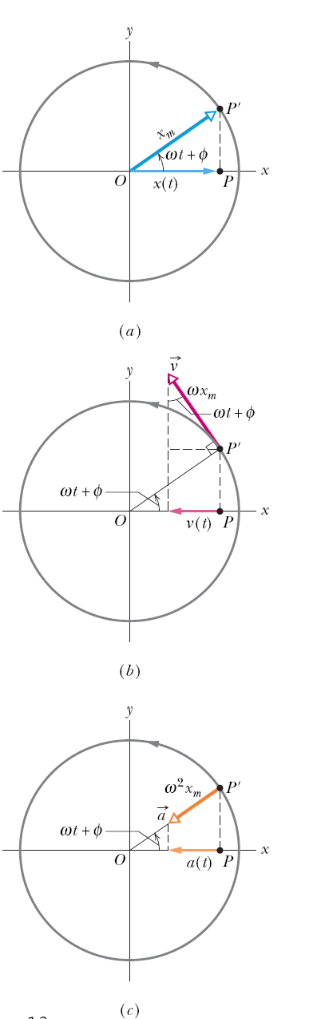

SHM and uniform circular motion
Consider a reference particle P’ moving in uniform circular motion with constant angular speed (w).
The projection of the particle on the x-axis is a point P, describing motion given by:
This is the displacement equation of SHM.
SHM, therefore, is the projection of uniform circular motion on a diameter of the circle in which the circular motion occurs.

Slide 22

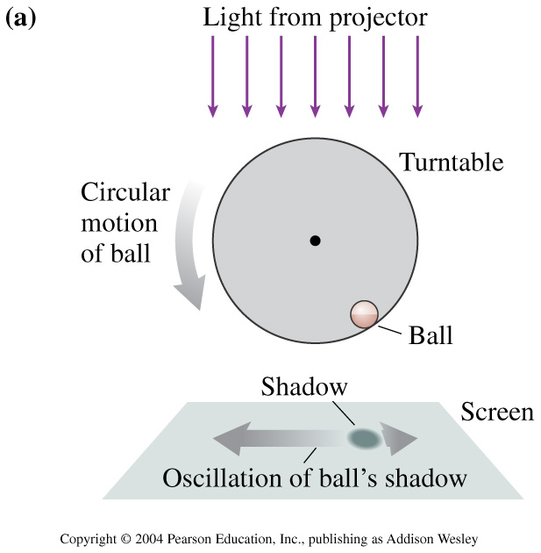
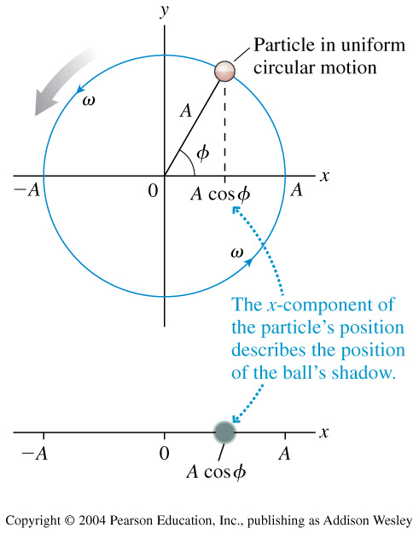
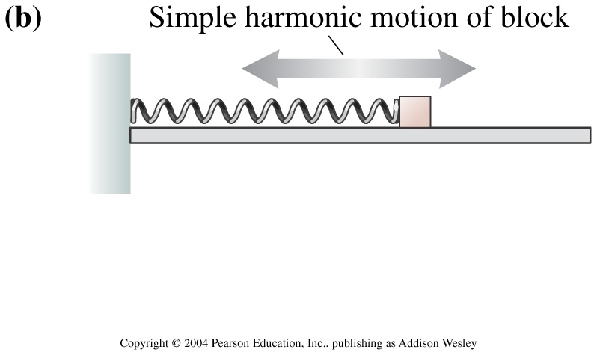
Uniform circular motion can be considered a combination of two simple harmonic motions, one along the x axis and one along the y axis, with the two differing in phase by 90°.
http://surendranath.tripod.com/Applets/Oscillations/SHM/SHM.html

